Slide 1

First-Fit and Clock Algorithms
Done by:
Akzhol Sovet
Mirolim Saidakhmatov
BDA-1902

Slide 2
literature
Internet resources

Slide 3
First-fit
This method keeps the free/busy list of jobs organized by memory location, low-ordered to high-ordered memory.
In this method, first job claims the first available memory with space more than or equal to its size.
The operating system doesn’t search for appropriate partition but just allocate the job to the nearest memory partition available with sufficient size.[2]

Slide 4
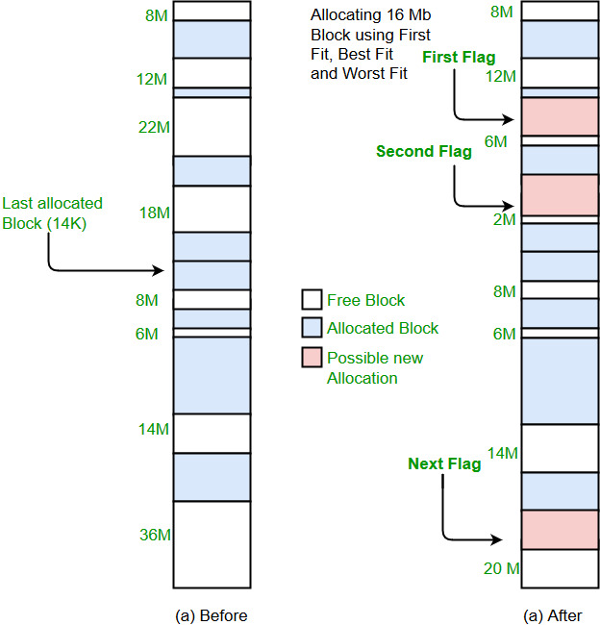
[2]

Slide 5
Implementation
Input memory blocks with size and processes with size
Initialize all memory blocks as free
Start by picking each process and chck if it can be assigned to current block
If size-of-process <= size-of-block if yes then assign and check for next process
If not then keep checking the further blocks [2]

Slide 6
class FirstFit { static void firstFit(int blockSize[], int m, int processSize[], int n) { int allocation[] = new int[n]; for (int i = 0; i < allocation.length; i++) allocation[i] = -1; for (int i = 0; i < n; i++) { for (int j = 0; j < m; j++) { if (blockSize[j] >= processSize[i]) { allocation[i] = j; blockSize[j] -= processSize[i]; break; } } } System.out.println("\nProcess No.\tProcess Size\tBlock no."); for (int i = 0; i < n; i++) { System.out.print(" " + (i + 1) + "\t\t" + processSize[i] + "\t\t"); if (allocation[i] != -1) System.out.print(allocation[i] + 1); else System.out.print("Not Allocated"); System.out.println(); } } }

Slide 7
public class main { public static void main(String[] args) { int blockSize[] = {100, 500, 200, 300, 600}; int processSize[] = {212, 417, 112, 426}; int m = blockSize.length; int n = processSize.length; FirstFit.firstFit(blockSize, m, processSize, n); } }

Slide 8
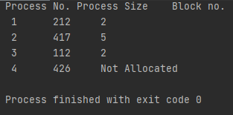
Output:

Slide 9
Clock(Second chance)
In the Second Chance page replacement policy, the candidate pages for removal are considered in a round robin matter, and a page that has been accessed between consecutive considerations will not be replaced.
The page replaced is the one that, when considered in a round robin matter, has not been accessed since its last consideration.
[3]

Slide 10
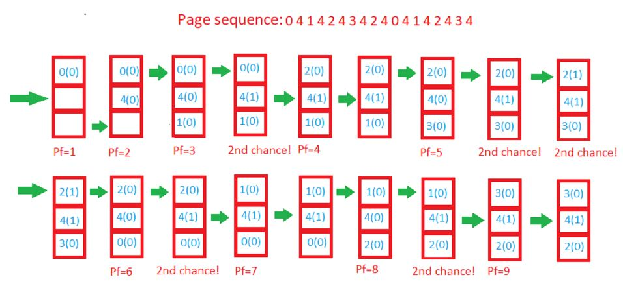

Slide 11
Implementation
Algorithm – create an array frames to track the pages currently in memory and another Boolean array second_chance to track whether that page has been accessed since it’s last replacement (that is if it deserves a second chance or not) and a variable pointer to track the target for replacement.
Start traversing the array arr. If the page already exists, simply set its corresponding element in second_chance to true and return.
If the page doesn’t exist, check whether the space pointed to by pointer is empty (indicating cache isn’t full yet) – if so, we will put the element there and return, else we’ll traverse the array arr one by one (cyclically using the value of pointer), marking all corresponding second_chance elements as false, till we find a one that’s already false. That is the most suitable page for replacement, so we do so and return.
Finally, we report the page fault count.
[3]

Slide 12
//If page found, updates the second chance bit to true static boolean findAndUpdate(int x,int arr[], boolean second_chance[],int frames) { int i; for(i = 0; i < frames; i++) { if(arr[i] == x) { //Mark that the page deserves a second chance second_chance[i] = true; //Return 'true', that is there was a hit //and so there's no need to replace any page return true; } } //Return 'false' so that a page for replacement is selected //as he reuested page doesn't exist in memory return false; }
import java.util.*; import java.io.*; class secondChance { public static void main(String args[])throws IOException { String reference_string = ""; int frames = 0; //Test 1: reference_string = "0 4 1 4 2 4 3 4 2 4 0 4 1 4 2 4 3 4"; frames = 3; //Output is 9 printHitsAndFaults(reference_string,frames); //Test 2: reference_string = "2 5 10 1 2 2 6 9 1 2 10 2 6 1 2 1 6 9 5 1"; frames = 4; //Output is 11 printHitsAndFaults(reference_string,frames); }

Slide 13
//Updates the page in memory and returns the pointer static int replaceAndUpdate(int x,int arr[], boolean second_chance[],int frames,int pointer) { while(true) { //We found the page to replace if(!second_chance[pointer]) { //Replace with new page arr[pointer] = x; //Return updated pointer return (pointer+1)%frames; } //Mark it 'false' as it got one chance // and will be replaced next time unless accessed again second_chance[pointer] = false; //Pointer is updated in round robin manner pointer = (pointer+1)%frames; } } static void printHitsAndFaults(String reference_string, int frames) { int pointer,i,l,x,pf; //initially we consider frame 0 is to be replaced pointer = 0; //number of page faults pf = 0; //Create a array to hold page numbers int arr[] = new int[frames]; //No pages initially in frame, //which is indicated by -1 Arrays.fill(arr,-1);
//Create second chance array. //Can also be a byte array for optimizing memory boolean second_chance[] = new boolean[frames]; //Split the string into tokens, //that is page numbers, based on space String str[] = reference_string.split(" "); //get the length of array l = str.length; for(i = 0; i<l; i++) { x = Integer.parseInt(str[i]); //Finds if there exists a need to replace //any page at all if(!findAndUpdate(x,arr,second_chance,frames)) { //Selects and updates a victim page pointer = replaceAndUpdate(x,arr, second_chance,frames,pointer); //Update page faults pf++; } } System.out.println("Total page faults were "+pf); } }

Slide 14
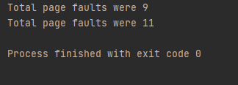
Output

Slide 15
references
Last visited 13th of March, 2021
https://www.geeksforgeeks.org/program-first-fit-algorithm-memory-management/ [1]
https://www.geeksforgeeks.org/first-fit-allocation-in-operating-systems/ [2]
https://www.geeksforgeeks.org/second-chance-or-clock-page-replacement-policy/ [3]

